Slide 1
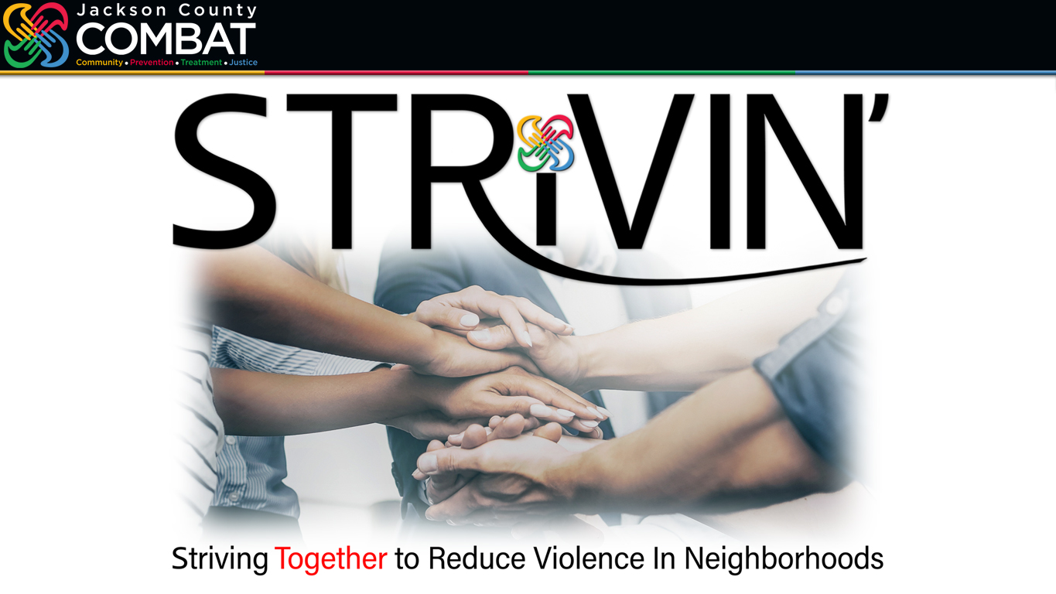
jacksoncountycombat.com/STRiVIN
Notes:
PRESENTED 06/21/23 COMBAT Impact Symposium PRESENTERS Joe Loudon (COMBAT Communications Administrator) & Vince Ortega (COMBAT Executive Director)
As Joe noted in COMBAT’s History presentation, COMBAT was always intended to be a holistic approach in addressing substance use disorders and drug related crimes that integrated criminal justice, treatment, and prevention.
Joe also quoted COMBAT’s first administrator, who stated, trying to bring prevention, treatment and law enforcement agencies together is as complex as landing a man on the moon. He said, “We’re flirting with the idea of how to do it.”
The STRiVIN’ model, as you will see today, was designed and created to integrate criminal justice, treatment, and prevention agencies in a seamless way to address violence and drug abuse.
The STRiVIN’ objective is to foster communication, collaboration, and coordination of resources amongst COMBAT funded agencies, breaking down any existing silos that may have hindered effective cooperation in the past.
The STRiVIN’ model has a built-in infrastructure, a system, and a process to meet the needs of our most vulnerable families in Jackson County, utilizing all of COMBAT’s funded agencies comprehensively.
I will now turn it over to Joe, who will present an overview of the STRiVIN’ model from our early beginnings and where we are at to date.

Slide 2
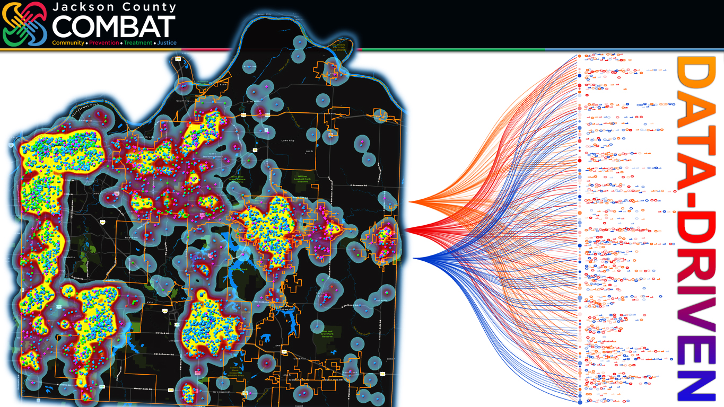
jacksoncountycombat.com/STRiVIN
Notes:
Statistics don’t tell the whole story, but statistics can help point you in the right direction.
So, COMBAT began using violent crime statistics—homicides, sexual assaults, assaults and robberies—to literally start charting a way forward.
To start being more data-driven by, first, generating “heat maps” to identify Jackson County’s violent crime “hot spots.”
When we then layered atop a heat map—similar to this one from several years ago—another map showing the locations where COMBAT-funded services were being provided, we immediately saw a problem.
The data doesn’t lie.
We had very few COMBAT-funded services being offered in the south Kansas City neighborhood of Ruskin Heights—at the time, one of the hottest hot spots in Jackson County.
Vince Ortega
As Joe mentioned, COMBAT wanted to be more data-driven and target focused, so we engaged and rely on all our Jackson County Police Department Partners, including the Sheriff's Department, to provide COMBAT with Monthly, violent crime and other related crime data.
COMBAT's Crime Analyst, Shannon Bobo, utilizing a GIS platform, geocode the data, create the Heat maps to identify the violent Crime Hot spots.
At the time, there were 18 violent crime hot spots throughout the County, 8 in Kansas City. No city is immune from violent crime.
What was alarming, half or more than half of the aggravated assaults in anyone hot spot were domestic violence-related.

Slide 3
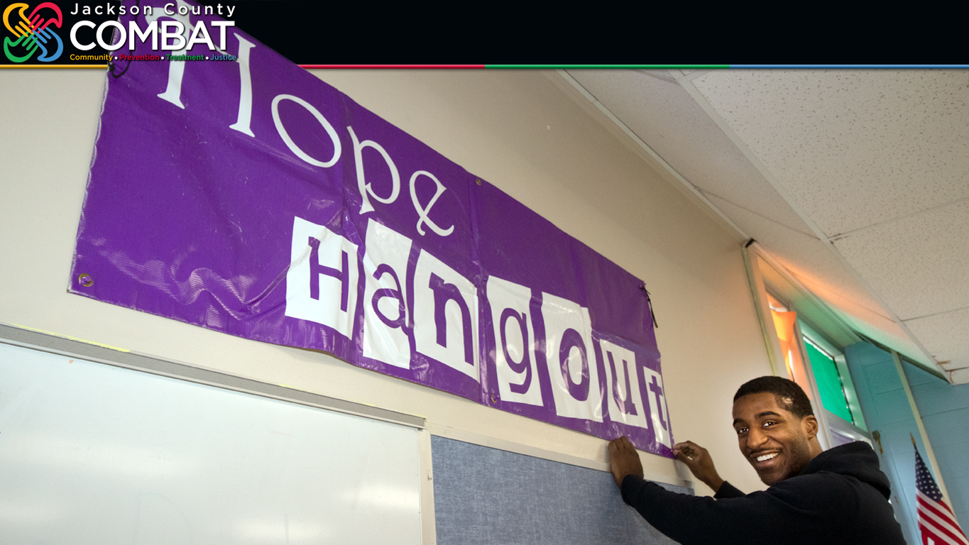
jacksoncountycombat.com/STRiVIN
Notes:
The lack of a COMBAT presence in Ruskin Heights chanced with the Hope Hangout…
Originally opening just down the street from Ruskin High School and now located inside the Hickman Mills alternative school at Burke Academy—this raising of the banner was from the 2021 move-in at Burke Academy.
The use of crime statistics and creation of the Hope Hangout marked a significant shift in how COMBAT operates.
For one thing, it got the COMBAT staff out of the office and engaging more directly in the community—rather being desk-bound all the time, reviewing grant applications or reading monthly reports.
And COMBAT asked more of the Hope Hangout—to be a service provider, a place where kids could hang out and find hope, but also a catalyst for organizing and coordinating services with other agencies, including the schools, police and faith-based leaders in the neighborhood.
What started with a little hope in 2015 has become the COMBAT STRiVIN’ initiative.
Striving To Reduce Violence In Neighborhoods.
Vince Ortega
The original STRIVIN Hub model was in the community room of the Bethel Family Church. Having a physical building in a targeted high crime neighborhood was a strategic one, as Joe pointed out, it provided a safe and accessible space for high-risk youth and their families to access a variety of social services.
One of the significant outcomes from youth and their families having a safe place to learn and socialize was the trust-building efforts.
By establishing strong relationships with the youth and their families, the Hub became a valuable source of information and support.
This knowledge of the community's challenges allowed for timely interventions and prevention tactics and strategies that we would discuss at our Monthly STRIVIN Hub meetings.
Again having, Community, Prevention, Treatment and law enforcement, partners at the table, for fostered collaboration, enhancing communication, and ensured that the efforts of all stakeholders were aligned in addressing crime trends and improving community safety.

Slide 4
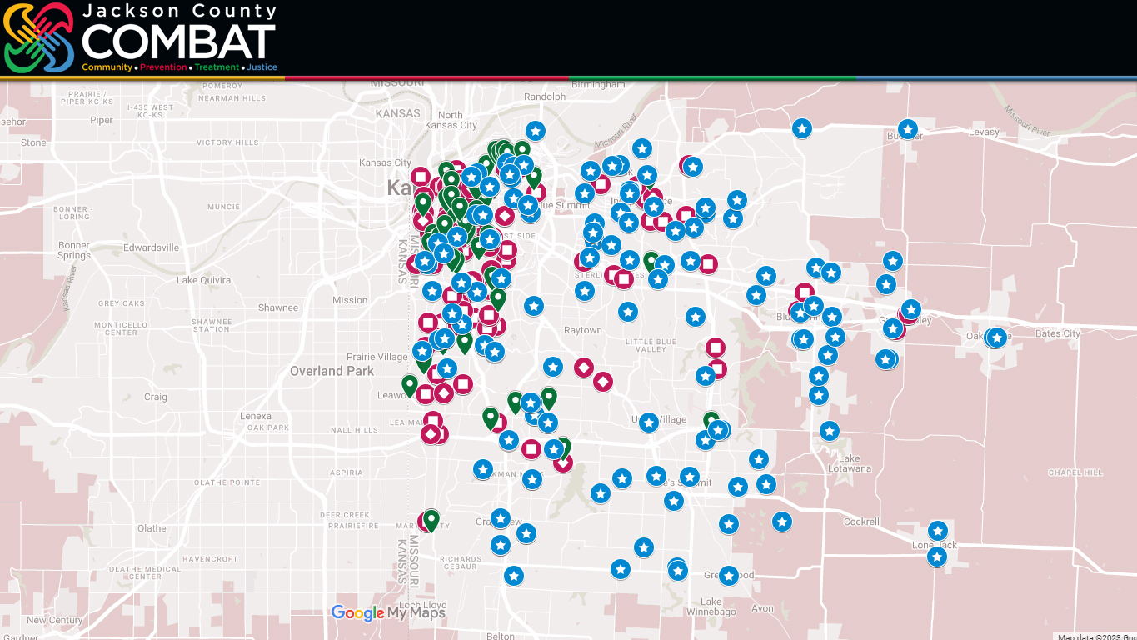
jacksoncountycombat.com/STRiVIN
93
Programs
378
Locations
Notes:
COMBAT is in a lot of neighborhoods.
In 2023 COMBAT is providing funding to support 93 different programs across Jackson County.
Prevention programs (in red), Treatment programs (in green) and Law Enforcement School-Based Initiatives (in blue).
Combined, these programs are offering services at (CLICK) 378 locations—with some programs being offered at the same location.
I want to note, we never publish the locations of domestic abuse shelters—for obvious security reasons. However, some COMBAT-supported programs are provided in these shelters.
There are program locations in every corner of the county. Programs in our smallest towns like Lone Jack and Buckner…
Most programs are, of course, concentrated where the most people live.
When you have this many programs… with this many locations… the response can be, “That’s impressive.”
Or…

Slide 5


jacksoncountycombat.com/STRiVIN
Notes:
Some people see a lot of locations—a lot of pieces scattered about—and just can’t see how it’s all supposed to come together.
In wondering if all this works, they begin to worry, “Is any of this working?”
What we are seeking to do through STRiVIN’ is to put the pieces together… To stop having each program—each piece—working on its own, only focused on its goals… To stop—and tell me if you’ve heard Vince Ortega say this before—”stop working in silos.”
The objective is put the pieces together… (CLICK) Collaborate… Be partners… Join forces… Work together…
Community… Prevention… Treatment… Justice…
Take all these pieces and work together to be more effective… be more impactful than any one piece can be alone.
Vince Ortega
While there is an impressive presence of COMBAT-funded programs throughout the county, the question of their effectiveness always arises, especially considering the persistently high levels of violent crime and drug abuse throughout the County.
The cluster of icons on the map that I pointed out, represents over 70 COMBAT-funded program locations, within a two-mile radius of the COMBAT Mid-Town STRiVIN’ Hub. Which is the Greater Metropolitan Church of Christ, located at 3735 Wabash.
The majority of these agencies do not communicate or collaborate with each other.
Over the years COMBAT has hired independent research and development firms to evaluate the effectiveness of COMBAT’s funded programs in reducing violence and drug abuse. These evaluations have generally demonstrated positive outcomes for each individual agency based on their own merit.
However, I recognize the need to go beyond isolated program evaluations and work towards collaboration to improve the overall effectiveness of COMBAT collectively and its impact on entire community.
This realization led to the creation of the COMBAT STRiVIN’ Hub model.

Slide 6
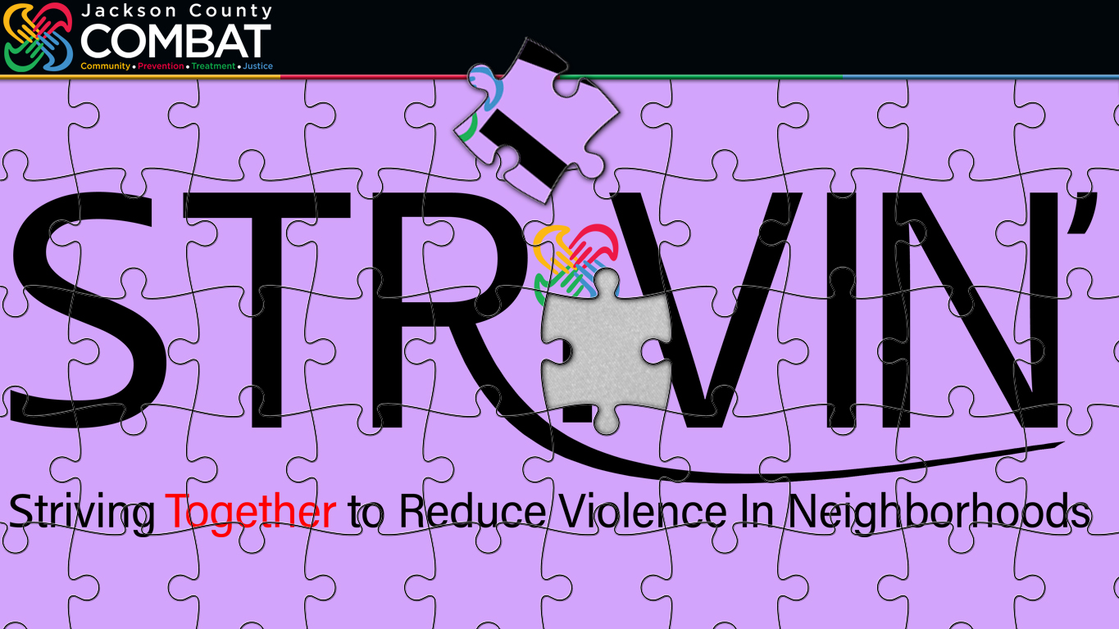
jacksoncountycombat.com/STRiVIN
Notes:
And that’s what STRiVIN’ does—put pieces together.
What are the pieces that form the STRiVIN’ initiative?
STRiVIN’ brings together School Administrators… Police Officers… Treatment Providers… Mental Health Care Professionals Social Workers Elected Officials Faith-Based Leaders Neighborhood Associations & Organizations COMBAT Staff COMBAT Commissioners And Concerned Citizens
With one COMBAT agency serving as the STRiVIN’ hub, tasked with being the coordinator in that neighborhood. (The Hope Hangout was the forerunner for the hubs that have followed.)
Expecting the police—alone—to reduce violence doesn’t work. (Although—still in 2023—that remains the go-to move in many, if not most, other communities across the nation.)
No one person… No one agency—alone—has all the answers.
We’re trying to find solutions by bringing together all these agencies… All these people with diverse backgrounds—different professions, difference expertise, different experiences…
To put all the pieces in place, we need agencies receiving COMBAT funding, yet not yet participating in STRiVIN’, to join this effort.
STRiVIN’ is the most comprehensive effort, to date, to bring our agencies together—there’s that word, again, together—to collaborate and coordinate, to strive to make each and every neighborhood a safe place to call home.
Vince Ortega
The collaborative approach taken by COMBAT staff in 2015, led to a significant reduction in violent crime in the Ruskin Neighborhood.
Through this process, it was discovered that youth gangs from the inner city were actively recruiting in the Ruskin area. This valuable information was obtained from input from various sources, including, the Hickman Mills School district, community members, the Kansas City Police Department's Gang Unit, and Family Court.
Working together and implementing coordinated interventions, the STRiVIN’ Hub members reduced violent crime by 33% over an 18-month period.
As a funder, it became clear that simply providing funding for programs is not enough, if the high-risk youth and their families who need these services, are not in the programs.
Recognizing this gap, COMBAT acted by funding social service workers to the STRiVIN’ Hubs to conduct outreach. By making welfare checks to over 30 homes in the Ruskin area, Marva Moses, and a police officer witness firsthand the social determinants of health that contribute to the challenging behaviors exhibited within the community, and in the schools.

Slide 7

jacksoncountycombat.com/STRiVIN
South Kansas City
The Hope Hangout
Hickman Mills Prevention Coalition
Burke Academy
1115 Bennington Avenue
Kansas City, MO 64134
Northeast Kansas City
The Mattie Rhodes Center
148 N. Topping Avenue
Kansas City, MO 64123
Midtown Kansas City
Greater Impact
Greater Metropolitan Church of Christ
3735 Wabash
Kansas City, MO 64109
Notes:
To date we have five STRiVIN’ hubs—three of them in Kansas City.
STRiVIN’ got its start in South Kansas City with The Hope Hangout, now in the Hickman Mills School District’s Burke Academy.
The Mattie Rhodes Center has been serving the community for more than 120 years—and is serving the Northeast as our STRiVIN’ hub in that historic neighborhood.
And we added a Midtown hub last summer through Greater Impact.

Slide 8
jacksoncountycombat.com/STRiVIN
Independence
Community Services League 16995 Dover Lane Independence, MO 64056
Raytown
The Safe Zone
(Sisters In Christ)
6108 Blue Ridge Boulevard
Raytown, MO 64133
Notes:
We have two STRiVIN’ hubs in Eastern Jackson County…
Community Services League in Independence…
And Sisters In Christ’s Safe Zone in Raytown…
Our hope is to soon add hubs in Blue Springs and elsewhere…

Slide 9
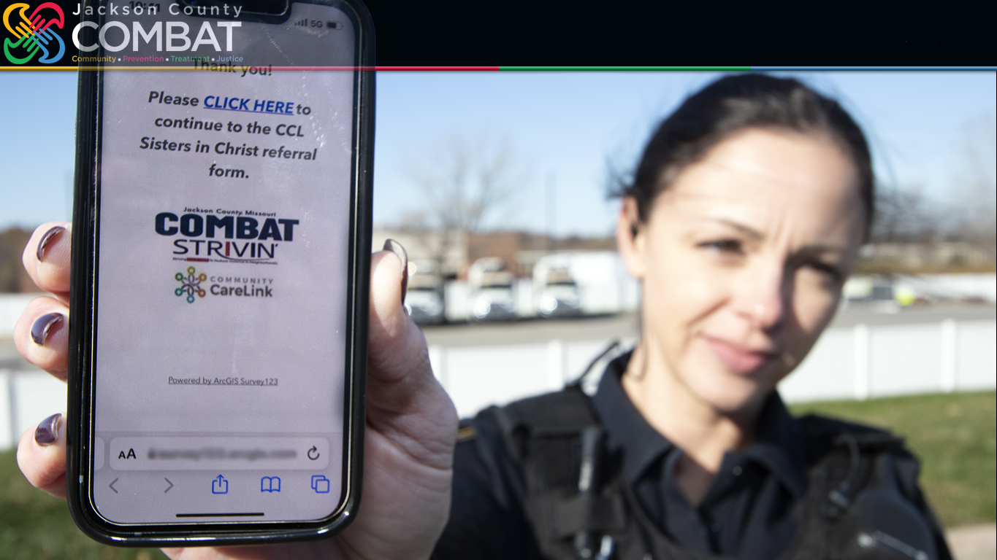
jacksoncountycombat.com/STRiVIN
Notes:
It was through STRiVIN’ that COMBAT introduced one of our most innovative programs to date.
Next month will mark two years since we launched—as a pilot program in Raytown—the STRiVIN’ Social Services Referral platform.
Our focus was then on the Raytown police—and bridging the gap between law enforcement and social services.
Bob Kuehl spent 35 years with the Kansas City Police, but when he became Police Chief in Raytown—just months before we began the pilot program—he soon saw that his new department was—in his words—”9-1-1 driven.”
As he said at the time, his officers “manage chaos and restore peace.” Then they must respond to the next emergency.
Through the STRiVIN’ Social Services Referral program, we provided the Raytown police a simple way to go beyond just managing chaos and restoring peace.
For example, if they are called to a home and see that there are several children and not enough food, that there’s a baby and not enough diapers, that Mom and Dad are stressed because they’re trying to decide how to pay the rent, that a single mom has lost her job and, with it, the health insurance her and her children depended on… The police officer can—on their phone—fill out a simple form and hit “submit.”
And just like that put a referral in for that family to receive social services.

Slide 10
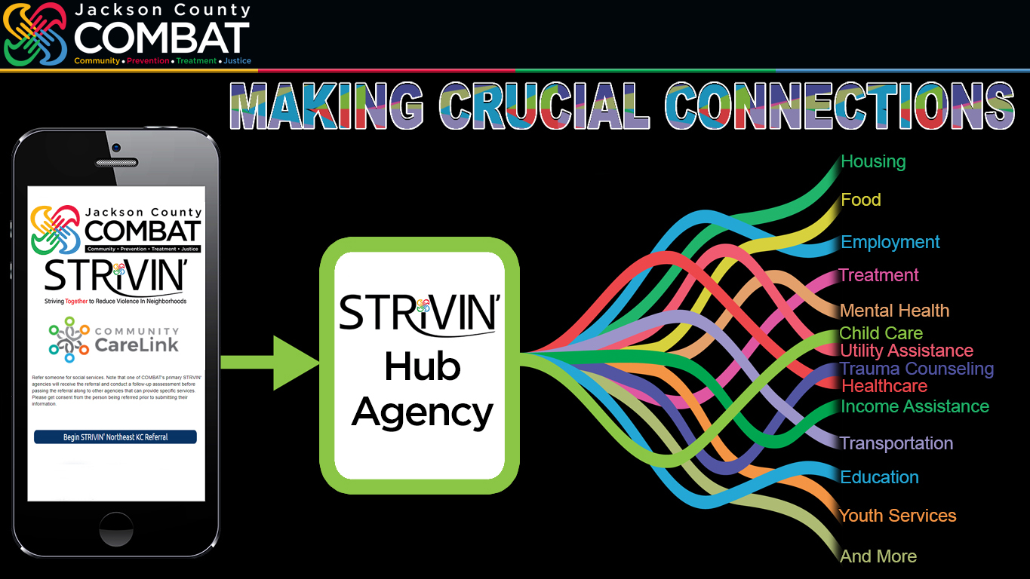
jacksoncountycombat.com/STRiVIN
Notes:
This is how it works. For the police officer, their work, regarding the referral, is over the moment they press submit.
The referral is sent directly to one of our COMBAT STRIVIN’ hub agencies.
The hub does all the follow-up work—by phone or in person.
They talk with the family or individual referred. Find out what their specific needs are.
Then they call other COMBAT agencies or tab into the Community Care Link network to connect the family or individual to a provider offering those specifics services. The network has grown to more than one thousand services providers.
The range of assistance available is wide and varied—unemployment, income aid, utility support, food, mental health care, substance abuse treatment and much, much more.
With the pilot program taking off in Raytown, we have since expanded it to each STRiVIN’ neighborhood.
And those now making referrals include school administrators, other COMBAT agencies, COMBAT staff… Through the city’s Partners for Peace initiative the survivors of gun shot wounds and surviving family of homicide victims are now being referred.
The referral form starts a process that is tracked through Community Care Link’s HIPAA-compliant database.
Vince Ortega
The STRIVIN online Social Service referral application, that is hosted on the Community Care link software, serves as a crucial infrastructure and case management platform for coordinating and monitoring social service resources.
It also enhances the efficiency, accountability, and effectiveness of social service deliveries.
Additionally, it is a unified platform to connect resources, track client progress, and ultimately ensure that individuals receive the support they require without being lost through the cracks of society's systems.

Slide 11
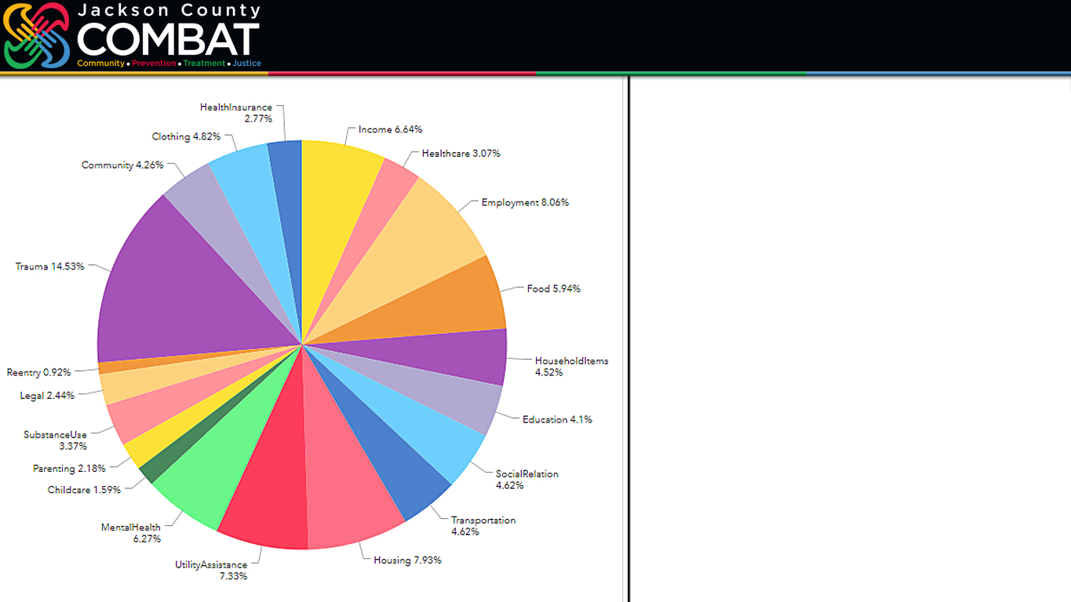
jacksoncountycombat.com/STRiVIN
1,032 Referrals
July 1, 2021 – June 14, 2023
3,028 Areas Of Need
Notes:
From July 1, 2021 through June 14, 2023, a total of 1,032 referrals had been made.
Each referral represents real people… real families… with real issues…
As you’d expect, many of the individuals and families being referred have more than one area of need.
Therefore, while we’ve had 1,032 individual, they had 3,028 areas of need based on the Social Services Determinants of Health.
You could have one person, for example, needing income assistance, housing, mental health care. One person, three areas of need.
Vince Ortega
This Pie Chart and its linked Dashboard was created and updated weekly by COMBAT’s Crime analyst, Shannon Bobo.
As you can see, social determinant of health refers to the social, economic, and environmental factors that influence an individual's health status and Safety.
Shannon tracks these social determinants of health, by not only category, but also by zip code.
Recognizing and understanding these factors helps COMBAT as a funder, policymakers, healthcare providers, and communities develop interventions and policies that address the root causes of violence and drug abuse in our most vulnerable communities.

Slide 12
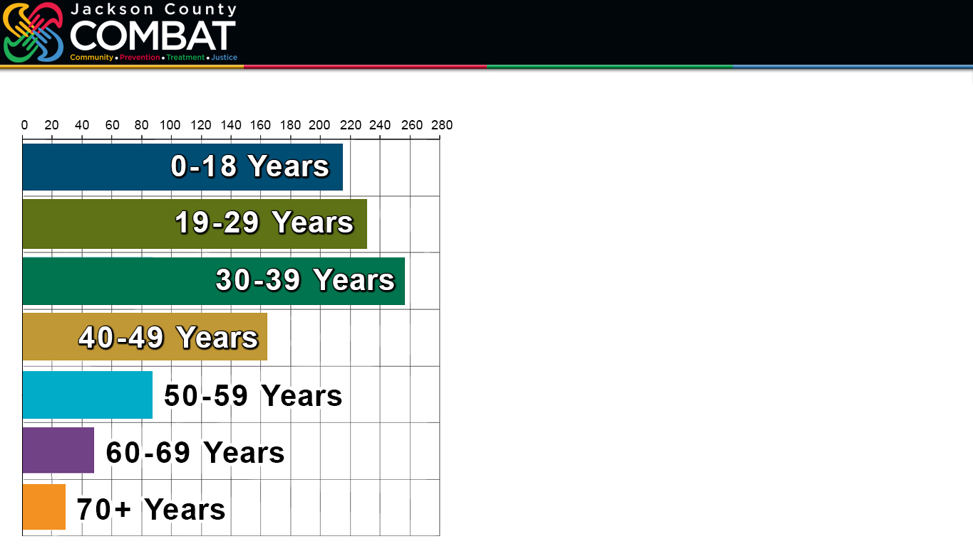
jacksoncountycombat.com/STRiVIN
Number Of Referrals By Age
Female 552
Male 452
Unknown 28
215
232
257
Black or African American 636
White 167
Unknown 131
Hispanic/Latino 71
164
87
48
29
Notes:
While access to specific client information is restricted, in accordance with HIPAA guidelines, we can, through this referral system, collect valuable data.
Again, we want to be data-driven. And this system is allowing us to go beyond just crime statistics to trying to truly help people.
Who needs assistance?
With breakdowns based on age…
This is just an observation…
STRiVIN’ has been very much youth-focused, but as this data shows we’ve got a lot of people under 50, under 40 needing assistance. Many in those 19-to-29 and 30-to-39 age ranges may have children. They are parents struggling, having issues—whose struggles and issues are no doubt impacting their children.
The demographic data also identifies those being referred—or in some cases self-referring—
(CLICK) Based on gender…
(CLICK) And race…
As Joe pointed out, the STRIVIN Hubs focused on high-risk youth initially.
However, as our Hubs begin to conduct outreach to these youth family homes, we all begin to understand the bigger picture, as we discovered:
- A history of family violence
- Generational poverty
- Domestic violence
- Mental health concern
- Sex abuse issue
We learned by addressing the systemic issues and providing support that encompasses the entire family unit, with WRAP around services, you can start to effectively break the cycle of violence and drug abuse.
I can tell you for a fact, that the Raytown School District refers entire families, not just their trouble students, to the Raytown STRIVIN Hub.

Slide 13
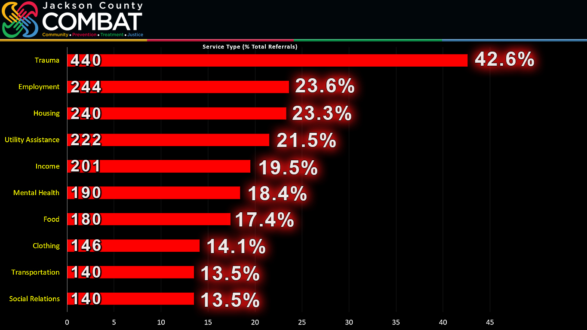
jacksoncountycombat.com/STRiVIN
% Of 1,032
Types Of Services
Assistance Needed
Notes:
Perhaps most importantly this database is helping us determine what types of assistance are needed most.
Based on the 1,032 referrals submitted through last Wednesday—June 14—these are the most often types of services mentioned.
Unlike the pie chart I showed you earlier, based on service types, the percentages here are based on people, the 1,032 referrals received.
And, again, because one person can have need for more than one type of assistance the percentages here won’t add up to 100%.
Of the 1,032 referrals—1,032 people—42.6% were referred, in part, for Trauma.
Then we see a trend of economic issues—economic hardships—among the leading types of services needed: Employment and Housing Assistance, both at over 23%; Utility Assistance at 21.5%; Income Assistance 19.5%...
Mental Health care assistance is at 18.4%. Could that possibly be connected to untreated trauma?

Slide 14

jacksoncountycombat.com/STRiVIN
Notes:
What this data shows us is one thing that nearly one in this room already knew.
All roads often lead back to trauma.
We’ve gotten confirmation, once-again, about the impact of trauma. But we now have the data to clearly show it.
We are on the right path in stressing trauma-informed training and trauma-informed care…
… With the hope of stopping the negative chain-reaction that trauma can trigger in a person’s life.

Slide 15
jacksoncountycombat.com/STRiVIN
% Of 1,032
Types Of Services
Assistance Needed
Notes:
But this chart also reaffirms the struggles people are having with meeting their basic needs.
Many of you are familiar with Project RISE, started through COMBAT funding in 2019 by University Health/Truman Medical Centers.
The objective of Project RISE is to treat all the wounds a gunshot can inflict, both physical and psychological.
Survivors once stabilized in the emergency room may begin receiving what Project RISE calls psychological first aid. An emphasize is place on screening survivors for their long-term risk for PTSD.
But as the doctor who oversees the program has noted, he and his staff have been using our referral platform to help these survivors get all kinds of assistance.
A person can not focus on their long-term mental or physical well-being if they are having a daily struggle meeting their basic needs.

Slide 16
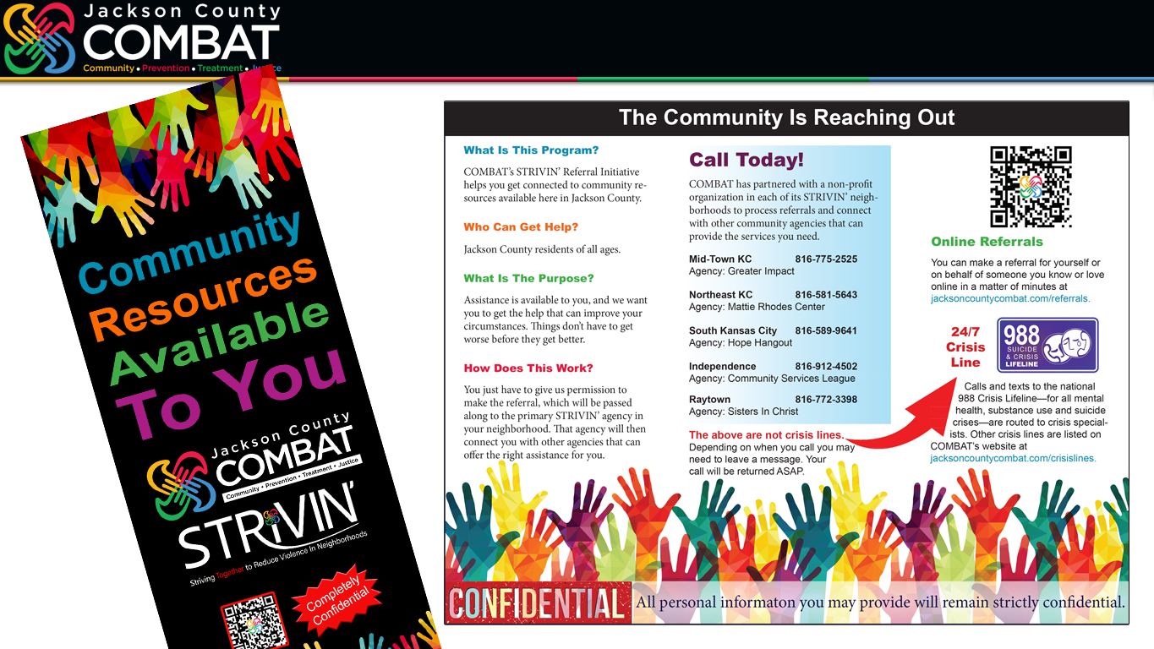
jacksoncountycombat.com/STRIVIN
Notes:
We understand not everyone needing assistance may feel comfortable wanting a referral made on their behalf.
Some people may not even realize they need assistance… Some may be too proud to ask for assistance…. Some may not be comfortable talking to a police officer…
We’ve created this brochure for police officers, school officials, our STRiVIN’ hubs to hand out, so that an individual can directly reach out and essentially refer themselves. So, that if they change their mind after initially saying no to being referred, they have the necessary contact information.
And we’ve made it clear on this brochure these hub numbers aren’t being answered 24/7… that they are not crisis lines…
But if called and a message is left, someone will respond.
I want to quote one paragraph from the brochure that sums up one of the key objectives of this Social Services Referral program: “Assistance is available to you, and we want you to get the help that can improve your circumstances. Things don’t have to get worse before they get better.”
We don’t want the situation in a person’s life to worsen, so that the police are called back to their home—and maybe this time someone has been hurt. We want to avoid that escalation—a turn toward violence.
We want people to get what could be life-changing or even life-saving assistance… For their benefit… For their next door neighbor’s benefit… for the whole neighborhood’s benefit…

Slide 17
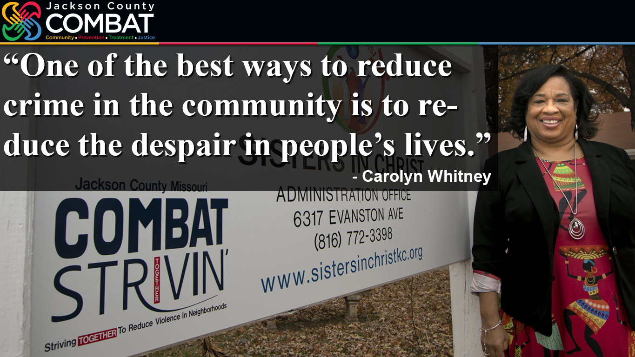
jacksoncountycombat.com/STRIVINreferrals
Notes:
The STRiVIN’ Social Services Referral program relies on our hubs to do the hard work—to do those follow-up assessments, track the clients.
Our hope is that if we can get enough people assistance—the right assistance to meet their specific needs—the police will have to manage less chaos, the schools will have fewer students struggling or causing disruptions, that violence and drug use and other problems will be reduced in our neighborhoods.
Before we strive to answer your questions, I’ll share with you these words of wisdom from Carolyn Whitney, director of Sisters In Christ, the hub agency in Raytown—where the first, of what is now more than 1,000 referrals, was sent.
“The Police alone are not the answer. It really takes the whole community. One of the best ways to reduce crime in the community is to reduce the despair in people’s lives.”
Vince
As noted, the COMBAT STRiVIN’ Social Service referral program relies heavily on our Hub Directors and staff to oversee the arduous task of working with people in crises, from the intake process to the follow-up procedure.
I will now turn it over to the Panelist who are Directors that oversee the COMBAT’s Five STRiVIN’ Hub throughout the County and who will provide you with their perspective on the STRiVIN’ Hub model and lessons learned from this process. And then take questions and answers.
Let’s start with introductions, and then respectfully, half the Ladies go First.

Slide 18
jacksoncountycombat.com/STRiVIN
Notes:
Vince
I really do not see STRiVIN’ as a program. When I hear the word program, I think of a set of activities, specialized in one area, that has an end date and start date, with a schedule hour or three hours in a week’s period.
When I think about STRiVIN’ Hub process, I compare it to a Continuum of Care, that emphasizes the need for collaboration and coordination among different service providers, organizations, and sectors to ensure that individuals receive the right care at the right time.
And by integrating and coordinating services across the continuum, it aims to improve outcomes, reduce fragmentation, and enhance the overall experience of individuals accessing care and support services, that has no end date.

