Slide 1
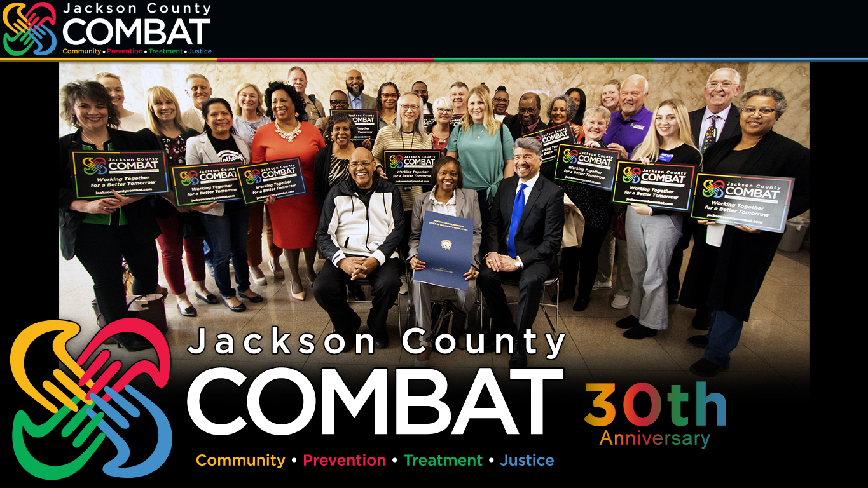
jacksoncountycombat.com
Notes:
PRESENTED 06/21/23 COMBAT Impact Symposium PRESENTER Joe Loudon (COMBAT Communications Administrator)
Let’s start with this photograph. Look at those beautiful people—brought together for a special occasion two months ago.
Vince asked our past directors and current commissioners to join him in accepting a special resolution from the Jackson County Legislature commemorating the 30th anniversary of COMBAT.
But we also wanted you there—our treatment and prevention program providers—to represent that COMBAT begins with, quite literally, community.
A community program… A community partnership… A community effort to make all of Jackson County safer and healthier.
An effort that was one of the first of its kind in the nation—one that would become a model for the rest of the nation.
And one that is still, even in 2023, unique in its holistic approach to addressing substance use disorders, drug-related crime and—since 2009—violence.
The resolution the County Legislature adopted two months ago read, in part: “COMBAT has for 30 years shifted the paradigm of the so-called ‘War On Drugs,’ from doing more than just fighting drugs and crime, to also helping people.”
A few months ago, Vince and Jean asked me to write a comprehensive history of COMBAT. I took the word “comprehensive” and ran with it—I ran a marathon with it.
The eight-part series is published on jacksoncountycombat.com. I think that history is something anyone involved in COMBAT today should at least become familiar with.
Today, I want to focus on some key points from the past that still resonate today—as we look forward to the future.

Slide 2
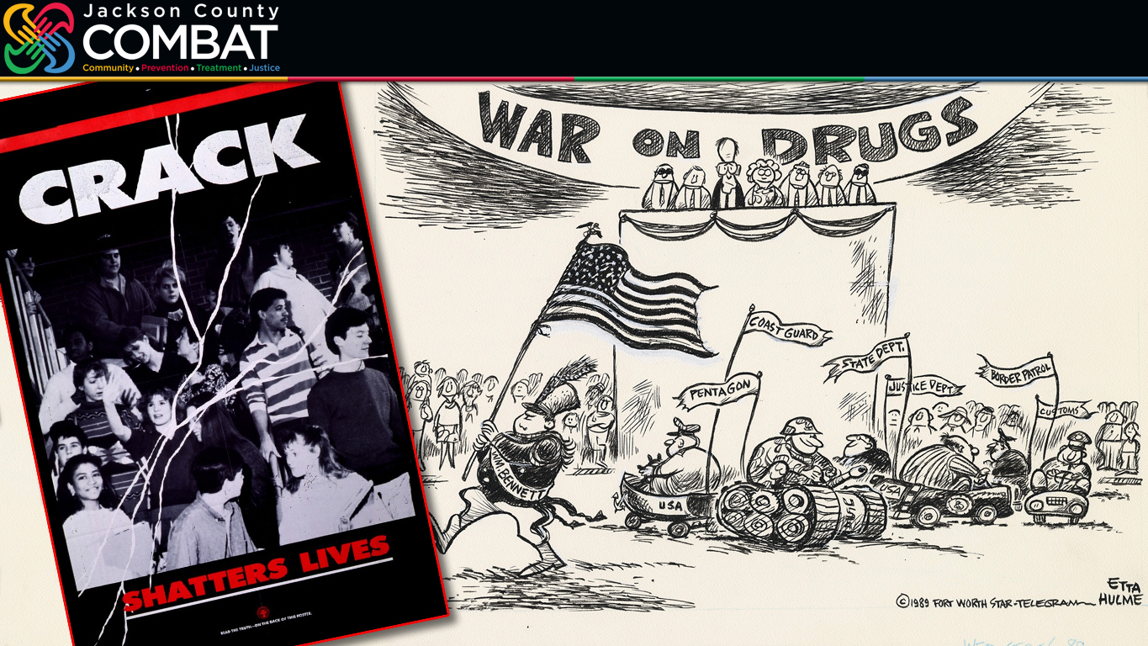
1989
Notes:
Let’s step back in time—to 1989.
Some of my all-time favorite movies were going to be released that year: You can’t be from Iowa and not love Field of Dreams… I thought I wanted to be a teacher and was inspired by Dead Poets Society… My mother taught me to always try and Do The Right Thing…
Joe Montana had just won his third Super Bowl playing for the San Francisco 49ers. And the Kansas City Chiefs had just started over, hiring a new coach, Marty Schottenheimer, and they would soon be drafting future hall-of-famer Derrick Thomas.
Bo Jackson was gearing up for an All-Star season in Royals blue—a baseball season that would end with a Bay Area World Series interrupted by an earthquake.
And in his first year as president, George H.W. Bush pledged to ramp up the “War On Drugs” that President Richard Nixon had declared in 1971.
President Bush committed every federal law enforcement agency and even the United States miliary to waging the war.
While the emphasis was clearly on enforcement, there were all kinds of attempts like this, CRACK SHATTERS LIVES, to spread the word, to warn kids and their parents.
The nation was beginning to just realize “just say no” just might not be enough.

Slide 3
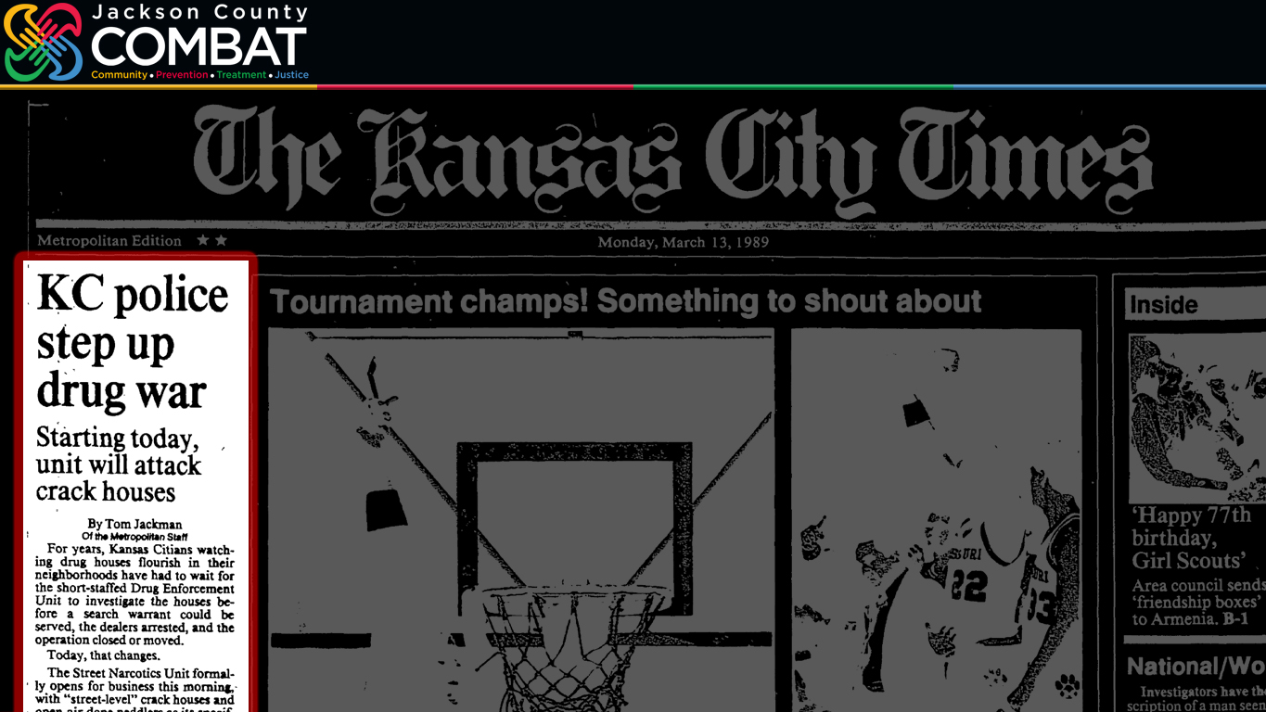
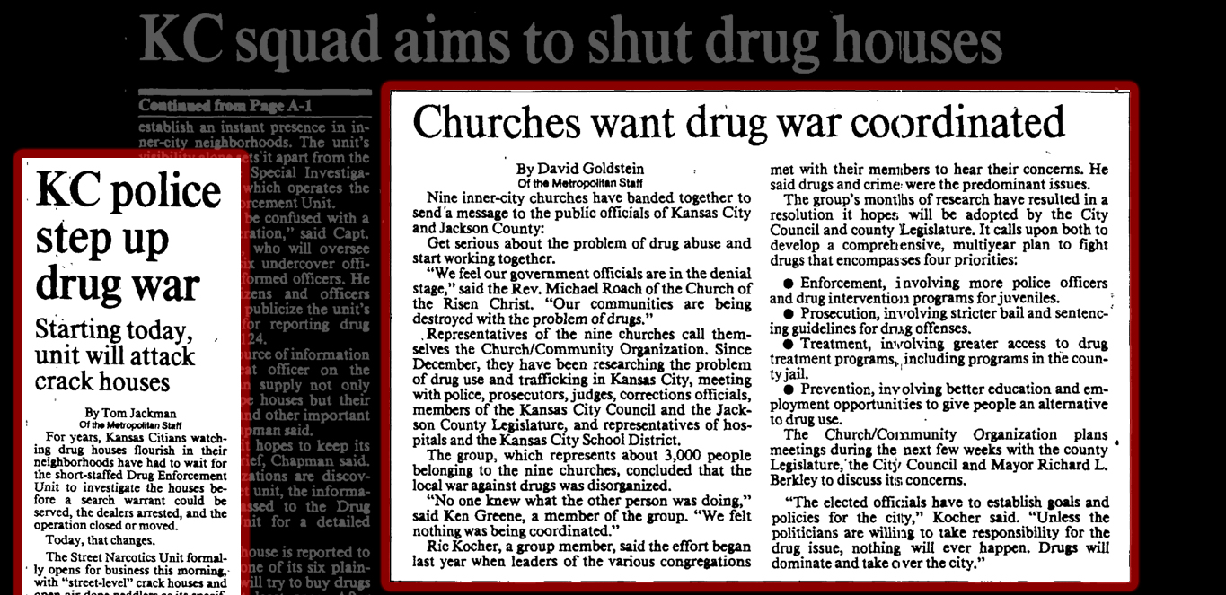
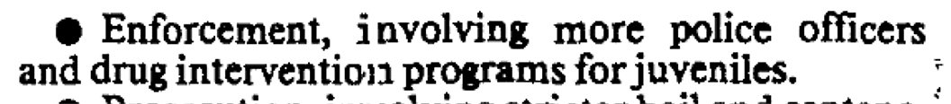
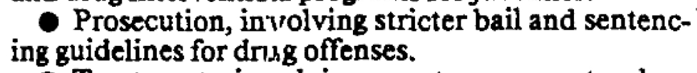
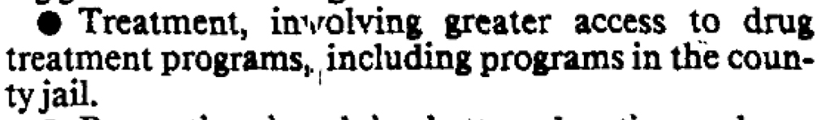
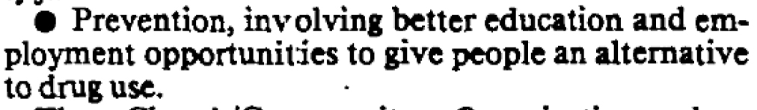
March 13, 1989
Notes:
Headlines like this one—in The Kansas City Times March 13, 1989—showed that the war would be waged on the local front.
But you had to turn the page (CLICK) to get at what would become the bigger story of 1989—about QUOTE “Nine inner-city churches… band[ing] together to send a message to the public officials of Kansas City and Jackson County. Get serious about the problem of drug abuse and start working together.” END QUOTE
They called for (CLICK) stronger enforcement, including “more police officers.” They wanted (CLICK) “stricter bail and sentencing guidelines.”
What set this call for escalation apart… While the rest of the nation was fixated on waging war and only waging it through tougher law enforcement, this group called for…
(CLICK) More treatment
(CLICK) And more prevention!

Slide 4
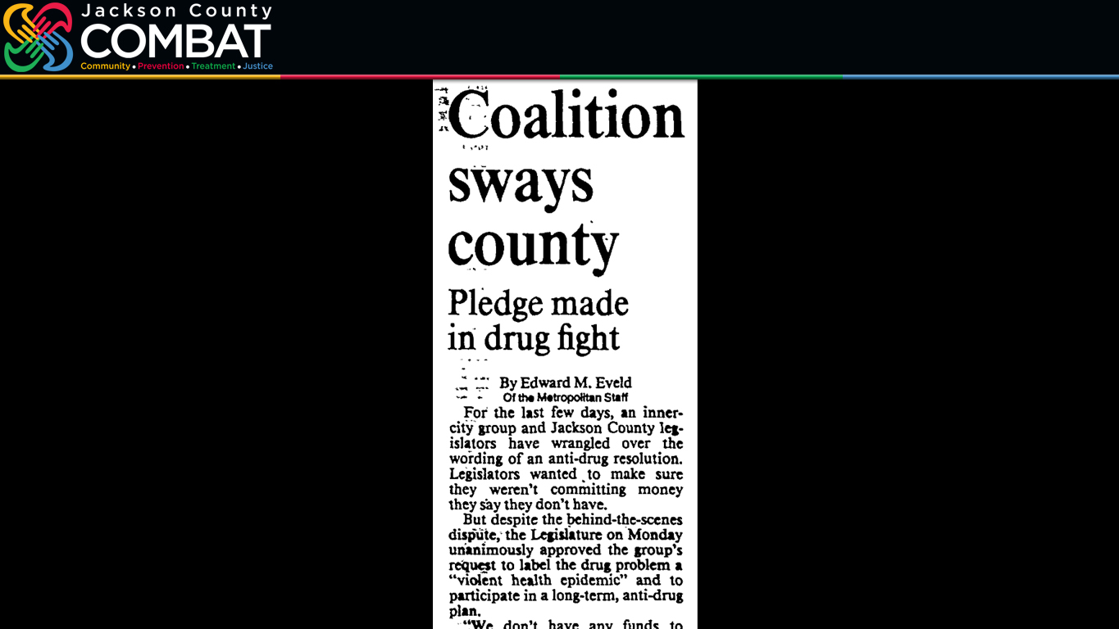
April 17, 1989
“Make
Drugs Your
Priority”
“Violent
Health
Epidemic”
“We don’t have any
funds to spend.”
Notes:
A month later, more than 100 people packed into the Jackson County Legislative chamber.
(CLICK) Many of those people were waving signs that read, “Make Drugs Your Priority.”
And the Legislature responded, (CLICK) passing a resolution to officially declare a “violent health epidemic.”
The Legislature called for a comprehensive multi-year response to the illegal drug emergency plaguing the county and most of the country.
But the Legislative chairman Fred Arbanas made it clear (PAUSE & CLICK), “We don’t have any funds to spend.”
That would soon change.

Slide 5
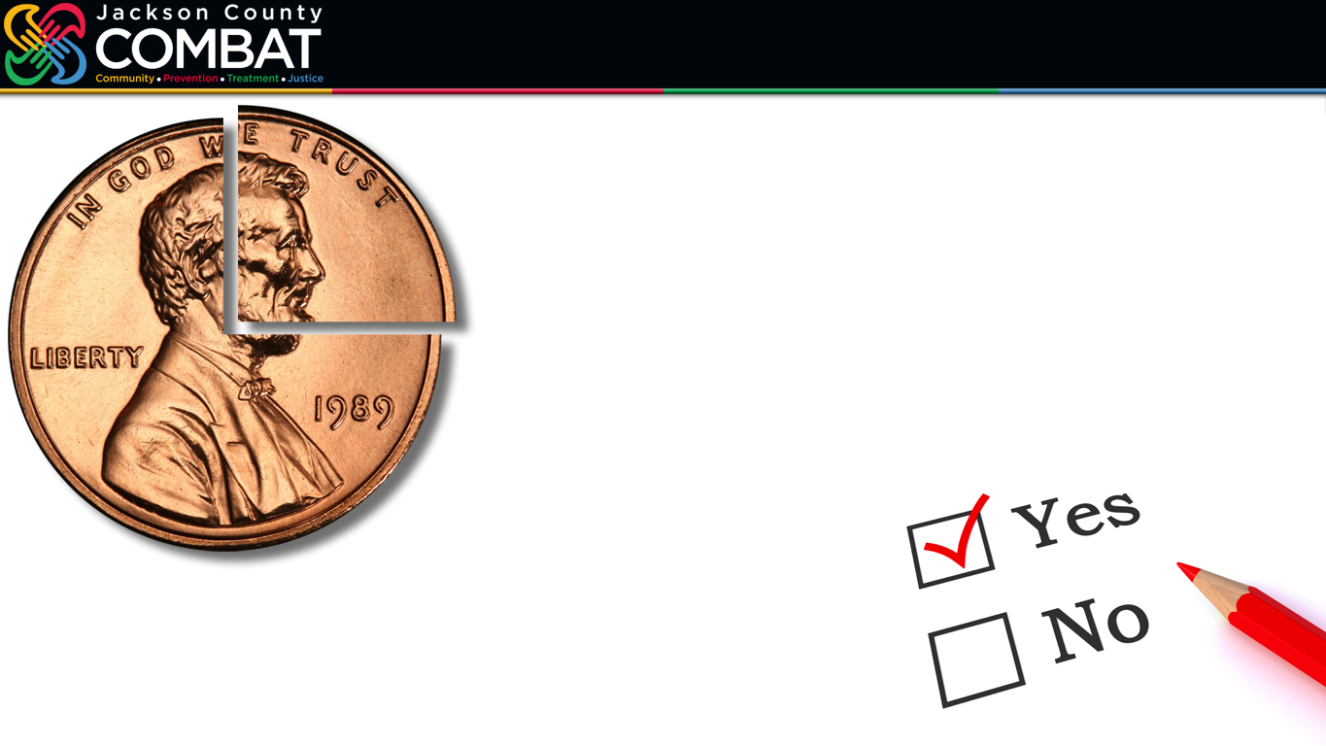
November 7, 1989
First In
The Nation
63% Support
Notes:
In November of 1989, Jackson County became the first jurisdiction in the country to approve a tax dedicated to reducing drug abuse and drug-related crime.
Despite there being some hesitancy from the County Legislature about putting the quarter-cent sales tax on the ballot, The Kansas City Star editorial board fully endorsed the measure, stating, “The bold step toward an anti-drug tax by the Jackson County Legislature could hardly have come at a better time.”
And the voters agreed.
(CLICK) They passed the tax with 63% support.

Slide 6

Summer & Fall 1989
“We’re convinced that [addiction] is an illness and should be dealt with as an illness.” Alvin Brooks
“Drugs are as big a Blue Springs problem as they are an anywhere-else problem.” Blue Springs Mayor John Michael
“It’s new, it’s innovative, and we’re going to be the people who try to do something.” Prosecutor Albert Riederer
Notes:
There were things said during the build-up to that election in 1989 that, I believe, still resonate today.
And, perhaps, from which we can find inspiration in 2023. (CLICK)
“We’re convinced that [addiction] is an illness and should be dealt with as an illness.” AdHoc Group Against Crime founder Alivn Brooks. (CLICK)
“Drugs are as big a Blue Springs problem as they are an anywhere-else problem.” Blues Springs Mayor John Michael. (CLICK)
“It’s new, it’s innovative, and we’re going to be the people who try to do something.” Jackson County Prosecutor Albert Riederer.

Slide 7
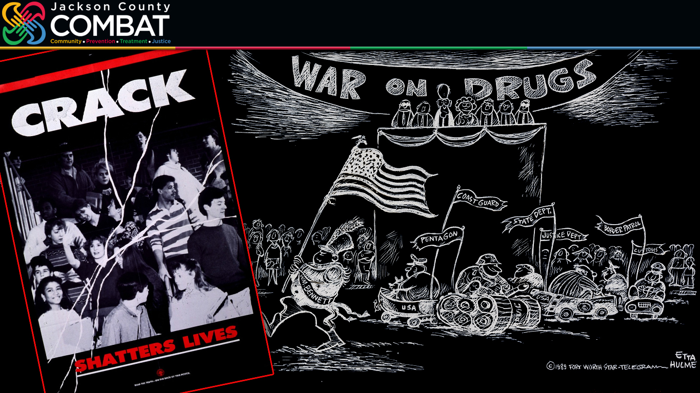
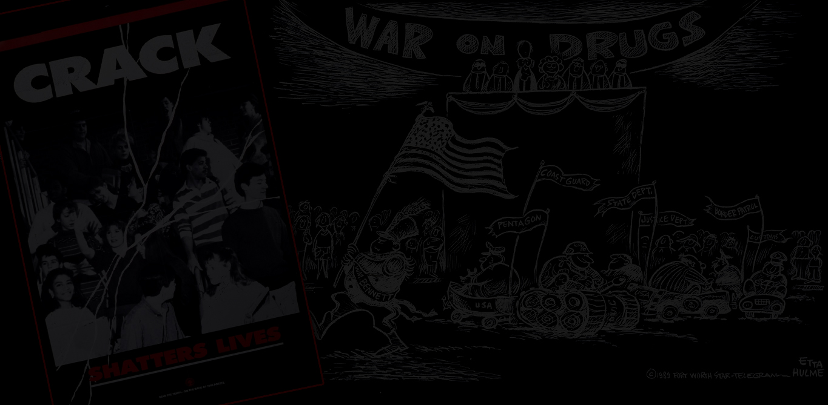
1989
“The problem we have with the drug problem is we’ve tried to cast it as a war. That is not necessarily fruitful. To just say we want tougher prosecution is a Band-Aid approach.”
Jackson County Legislator Robert Beaird
“The sales tax is a good step… It’s hard to believe that it will be the answer to everything.”
The Rev. Michael Roach
Notes:
Remember this was 1989. Most of nation was being put on a “WAR!” footing.
Jackson County was ahead of its time in not only passing this tax but in starting to shift attitudes toward how best to address drug addiction and drug-related crime: (CLICK-CLICK)
“The problem we have with the drug problem is we’ve tried to cast it as a war. That is not necessarily fruitful. To just say we want tougher prosecution is a Band-Aid approach.” Jackson County Legislator Robert Beaird.
And, finally, I like to think of this next quote as a keeping-it-real statement, when during that first campaign people were beginning to wonder if this tax would be a remarkable cure-all—and 30-plus years later some people still expect it to be: (CLICK)
“The sales tax is a good step… It’s hard to believe that it will be the answer to everything.” The Rev. Michael Roach.

Slide 8
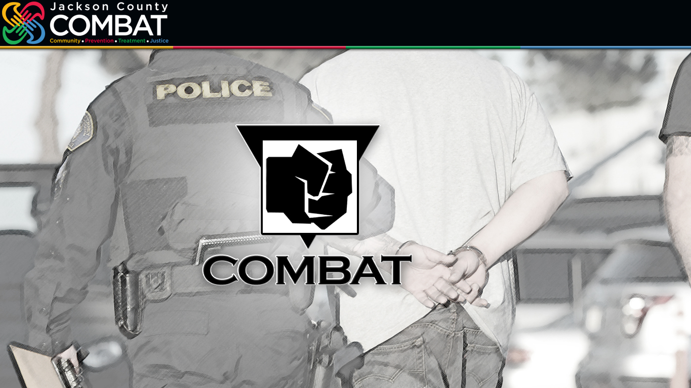
jacksoncountycombat.com/history
Notes:
From the beginning there have been disagreements, disputes and, pardon the pun, combativeness about how best to use these funds.
I kid you not. The headline in The Kansas City Star on November 8, 1989, the day after that first election, didn’t include the words “first in the nation…” No, the headline read: “With drug tax approved, tussle over money begins.”
For the record, the tax was passed in 1989, took effect April 1, 1990, but didn’t become the Community Backed Anti-Drug Tax until 1993—thus, again, making 2023 the 30th anniversary of COMBAT.
And as that first logo with the clenched fist made clear, COMBAT—in the early days—was focused heavily on enforcement.

Slide 9
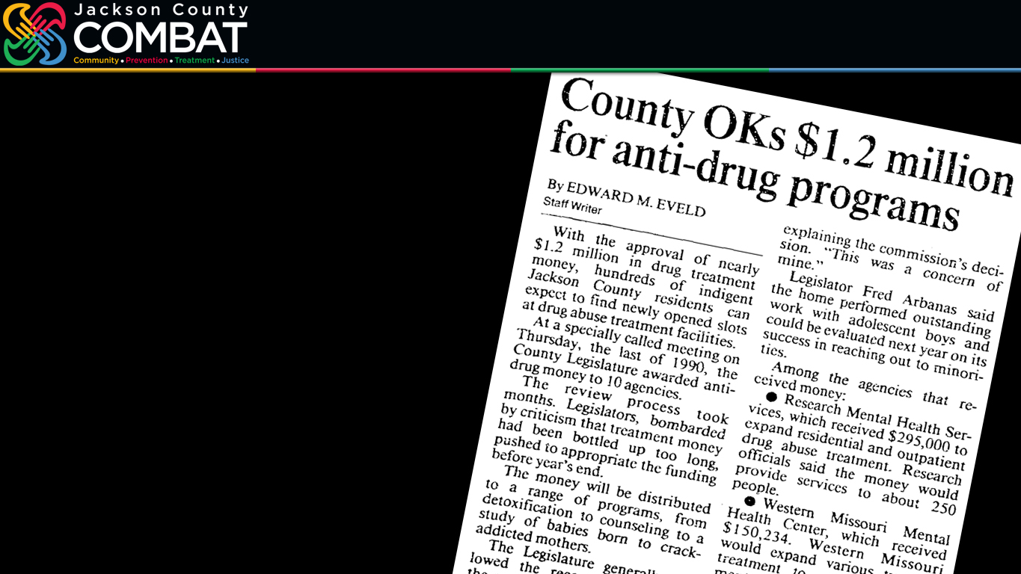
jacksoncountycombat.com/history
“I don’t know that five years in the penitentiary is going to cure either of those ills.”
Judge Donald L. Mason
Notes:
But from the start, there has been funding for treatment and prevention…
Starting with $1.2 million approved at the end of 1990 for 10 programs, mostly focused on treatment—from detoxification to funding a study to follow the long-term health of babies born to addicted mothers.
Even those in law enforcement would be emphasizing the need for more treatment… more prevention…
From the Jackson County Prosecutor in 1991… to the Kansas City Police Chief … to Judges like Donald L. Mason, who presided over the first session ever of the Jackson County Drug Court in 1993.
In volunteering to serve on the Drug Court, Judge Mason pointed to a recent case he oversaw involving a 22-year-old woman who had been addicted to cocaine since she was 13, and I’m using the words he used at that time in saying that at least two of her seven children had been “crack babies.”
When this young woman appeared before the judge yet again, he thought there must be a better alternative for her—to help her with her addiction—and to help her ailing children. He later said this (CLICK) “I don’t know that five years in the penitentiary is going to cure either of those ills.”
So, while COMBAT’s first logo featured that clenched first, compassion has always been essential to what we are trying to accomplish.

Slide 10

jacksoncountycombat.com/history
1995 71%
2003 64%
2009 71%
2016
73%
Notes:
Despite the disagreements, disputes, combativeness…
Support for COMBAT hasn’t waivered. Voters have extended the tax four times.
In 1995 (CLICK)
In 2003 (CLICK)
In 2009 (CLICK) With the election that year also expanding COMBAT’s mission to include violence prevention and officially changing the “anti-drug” tax into an “anti-crime” tax.
And finally in 2016 (CLICK) There had been concerned that putting the tax on the general election ballot—in a presidential election year—might make it more vulnerable.
Combined, 81,000 people voted in the 2003 and 2009 special elections. In the 2016 election, more than 300,000 voted and… (CLICK)
220,000 voted “YES!” to extend the tax through March 31, 2027.
But we should be aware—I think people do tend to take COMBAT for granted, but we should never take for granted COMBAT will always be here—for past success is no guarantee of future results.

Slide 11


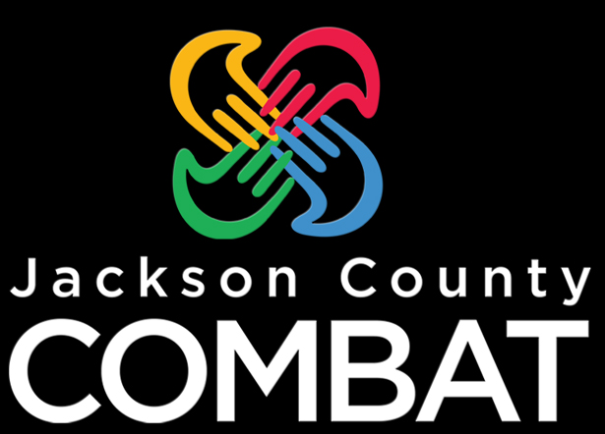


jacksoncountycombat.com
All Hands In!
Notes:
In designing our new logo…
I guess I have to mention what came after this original clenched logo—(CLICK) just to say if you have anything with this on—please dispose of it. This isn’t going to be a collector’s item.
When that second logo was unveiled in a County Legislative meeting—I still remember the reaction vividly a dozen years later—Legislator Fred Arbanas said, “Where’s the hope?”
So those words were one of our guides in redesigning.
(CLICK) First, We unclenched the fist to extend a helping hand.
(CLICK) Then we added color to represent that COMBAT is a vibrant and, yes, hopeful effort.
(CLICK) With different colors representing community, prevention, treatment and justice.
Then realized (CLICK & PAUSE) it takes “All Hands In!”
(CLICK) All hands in, forming a stronger bond than when they were apart.
This logo also goes back to COMBAT’s roots, in that there have been—since the start—calls for more coordination and collaboration And there has been criticism that there hasn’t been enough of either among the various agencies that COMBAT provides funding.
COMBAT’s first administrator described trying to bring prevention, treatment and law enforcement agencies together as being as complex as landing a man on the moon. He said, “We’re flirting with the idea of how to do it.”
We’ve made considerable progress in the last 30 years—and the last several years especially.
Of course, we asked you here today to remind us all that we are not in this alone and to help COMBAT in the ongoing effort to join hands… to work the problems in our neighborhoods together… to seek real solutions… and to make impactful changes in our community.

