Slide 1
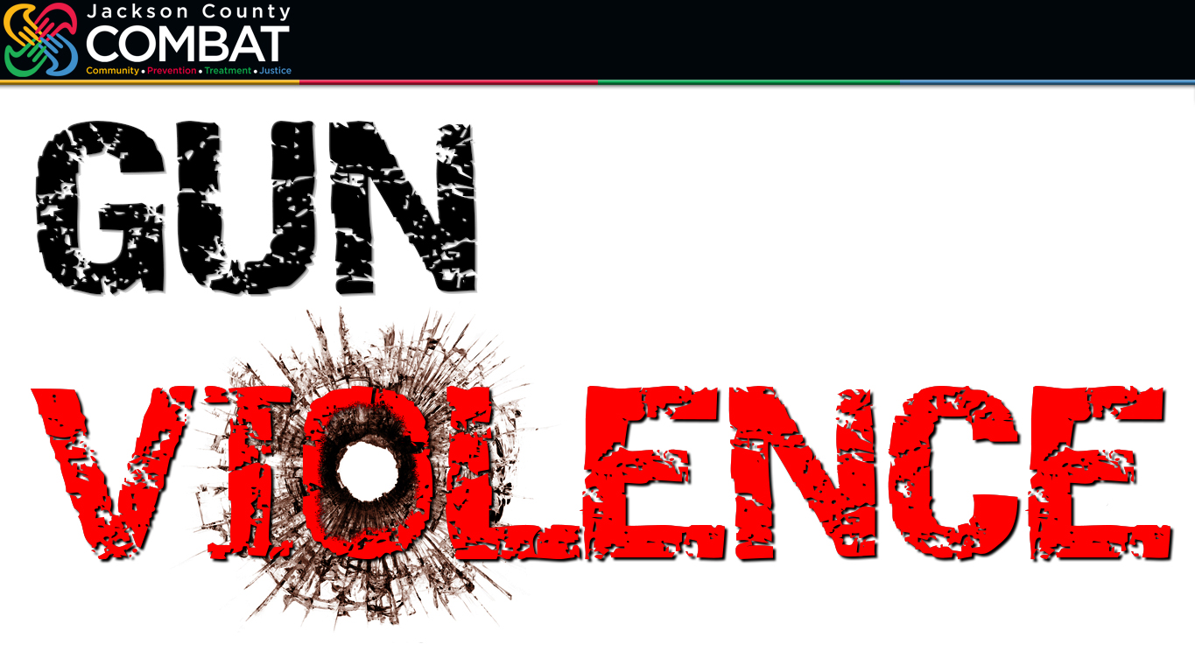
jacksoncountycombat.com
Notes:
PRESENTED 06/21/23 COMBAT Impact Symposium PRESENTERS Joe Loudon (COMBAT Communications Administrator) & Shannon Bobo (COMBAT Crime Analyst)
Were at the point, where we want to hear more from you. Ask you questions…
And—again, together—seek answers.
Unfortunately, we can’t discuss all the topics we suggested—and all the important ones that many of you suggested. We hoping for time this afternoon for some open discussion.
We decided to focus on two key issues—one related to COMBAT’s violence prevention mission, the other related to drug abuse prevention.
Now gun violence is, of course, an issue that impacts our country as a whole—our county in particular.
Missouri is home to two of the counties that rank among the top 10 in the nation in terms of gun violence per capita: St. Louis county is No. 1, and Jackson County is also in the top 10.
We aren’t going to now throw a lot of stats at you—and there is a lot of data out there on gun violence.
But there is one stat we’re going to share with you right now that we’d like you keep in mind as we proceed…

Slide 2
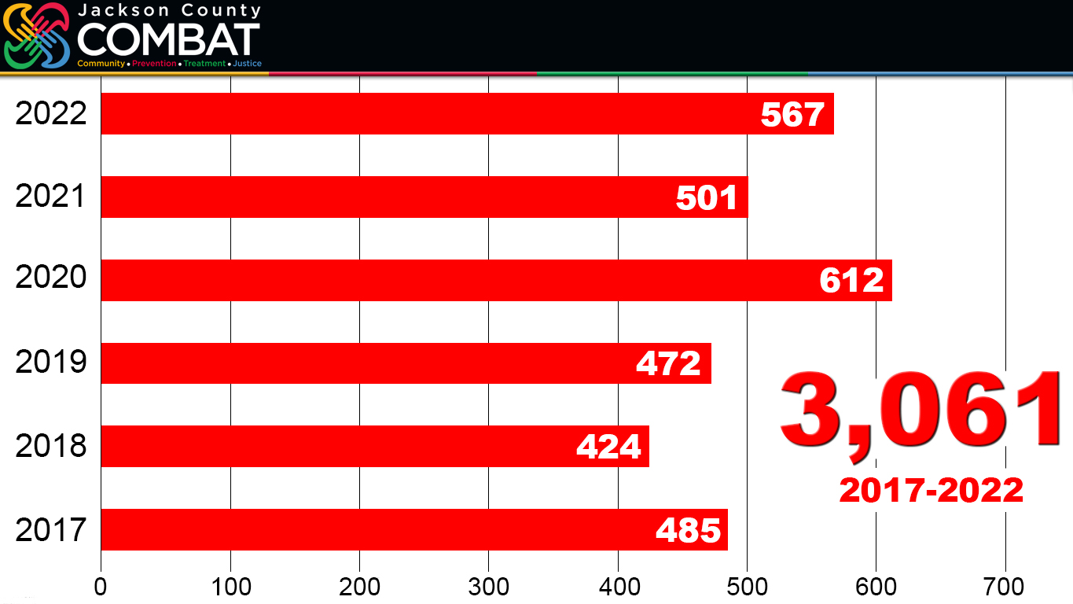
jacksoncountycombat.com
Notes:
We tend to focus, rightfully so, on homicides. The most serious act of violence.
But in Jackson County, from New Year’s Day 2017 through New Year’s Eve 2022, there were 3,061 non-fatal shootings.
Shootings in which someone was shot but survived. “Bullet-to-skin” is the expression you’ll hear used.
My uncle was a Navy corps in World War II, treating wounded Marine. As he told me once, “Personally, I don’t care if you were just grazed in the arm by a bullet… When a bullet has struck you—or even just grazed you—that is a near-death experience.”
And as many of you know those shot once are more likely to be shot again—being shot is rarely a once-in-a-lifetime experience—and they are more likely to later be the victim of a homicide.
And many of the non-fatal survivors may seek to retaliate, resulting in more shootings, more victims.

Slide 3
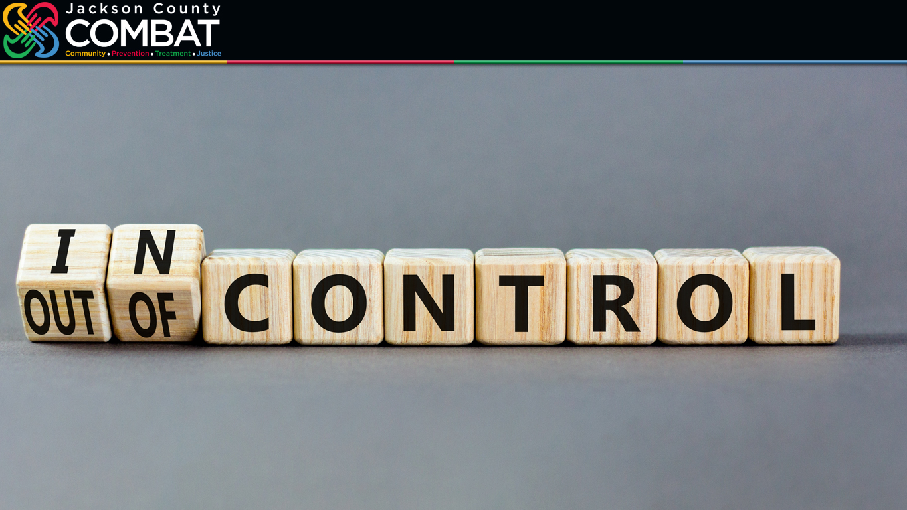
jacksoncountycombat.com
Notes:
Before we start asking you to discuss with those at your tables the question we want to pose, let’s remember one thing.
We want to focus on what we can do.
There are certain things beyond our control.
What happens in the legislative chambers, in Jefferson City and Washington DC, are beyond our control.
Jackson County COMBAT is a taxpayer-supported program, which means we are prohibited from advocating for or against any proposed legislation. As the old expression goes, we can education—not advocate.
Now those of you who aren’t government employees have a little more freedom to speak out…
But for our purposes today, let’s again, focus on what COMBAT—we together—can attempt to do.
In doing research about this topic, searching through Google for “recommendations to reduce gun violence,” almost all the recommendations required passing new laws.
So trying to develop a question that did not go into the realm of “out of our control” has not been easy.

Slide 4

jacksoncountycombat.com
What more can we do—that is IN OUR CONTROL—to reduce gun violence in our community?
Notes:
So, let’s ask of you a simple question—that may be difficult to answer.
What can we do together—that is IN OUR CONTROL—to reduce gun violence in our community?

