Slide 1
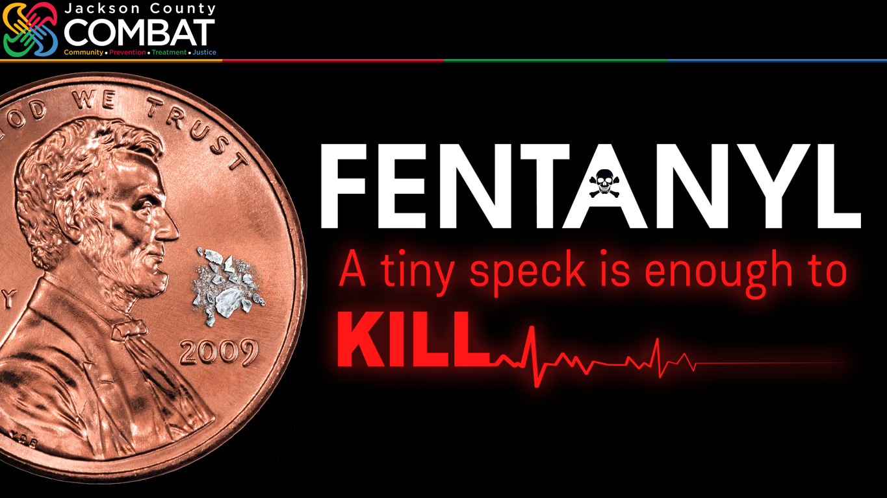
jacksoncountycombat.com/fentanylfacts
Notes:
PRESENTED 06/21/23 COMBAT Impact Symposium PRESENTERS Joe Loudon (COMBAT Communications Administrator) & Shannon Bobo (COMBAT Crime Analyst)
It was more than a year ago that Dr. Kelvin Walls, who serves on the COMBAT Commission, was asked about fentanyl and the risk it poses. His response was pretty blunt: “If you can see it, it can kill you.”
Just two milligrams of fentanyl—0.00007 ounces—can be a lethal dose. That’s about one-sixth the weight of a typical housefly.
And tragically fentanyl has become more and more common. With drug dealers mixing it with meth, cocaine, heroin…
And to make their counterfeit pills.
Fentanyl is, without question, one of… probably THE leading cause of overdose deaths increasing at an even more alarming rate over the last five years.
It should be noted that many of these overdoses have essentially been poisonings because the person taking the counterfeit pill may have only thought they were taking an Oxy pill.
That being said, dealers have also created a demand for fentanyl. Those suffering from a substance abuse addiction now find themselves dependent on fentanyl’s extreme potency. They’re asking the dealers, “Does this have fentanyl in it?”

Slide 2
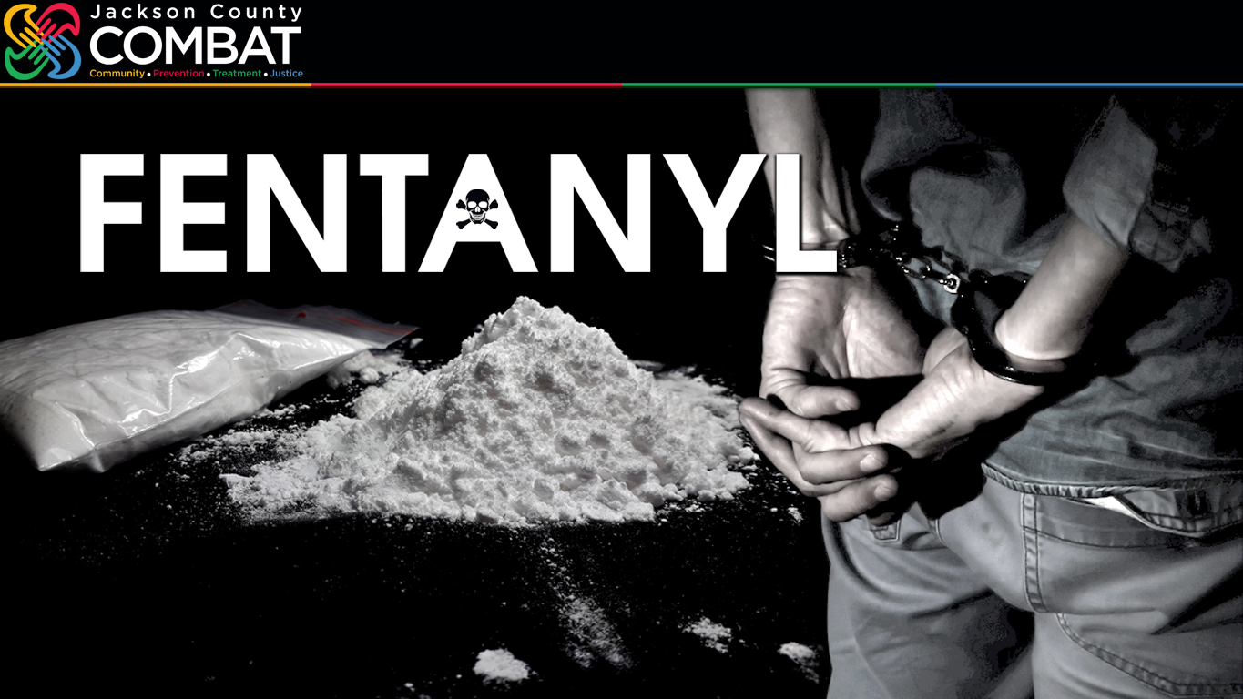
jacksoncountycombat.com/fentanylfacts
1 Investigation
22 lbs. Of Fentanyl
(Millions Of Lethal Doses)
Notes:
Just consider this… when you wonder how much fentanyl is being used.
In just one investigation in 2022, the COMBAT-funded Jackson County Drug Task seized 22 pounds of Fentanyl.
And remember it only takes 0.00007 ounces to be lethal.
As I’ve told our Drug Task Force officer-in-charge, “You are in the prevention business.”
In this case—one case—preventing enough fentanyl for approximately 5 million lethal doses from being put in drugs that would have been sold in our community.
Do the math? 5 million lethal doses… How many people live in our community—in the Greater Kansas City metropolitan area?

Slide 3
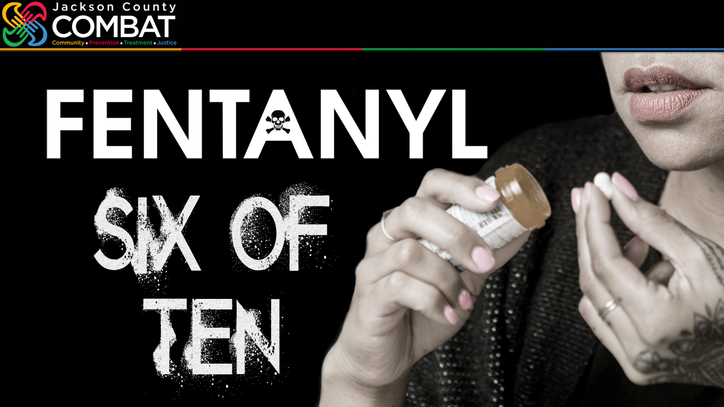
jacksoncountycombat.com/fentanylfacts
Notes:
Of course, with drug dealers, there is no quality control.
According to the Drug Enforcement Agency—and I did a double-take when I read this—of the counterfeit pills, laced with fentanyl, that the DEA lab test in 2022: Six in 10… 60%... had more than two milligrams of fentanyl.
Pills with as much five milligrams of fentanyl have been confiscated—more than double a lethal dose.

Slide 4
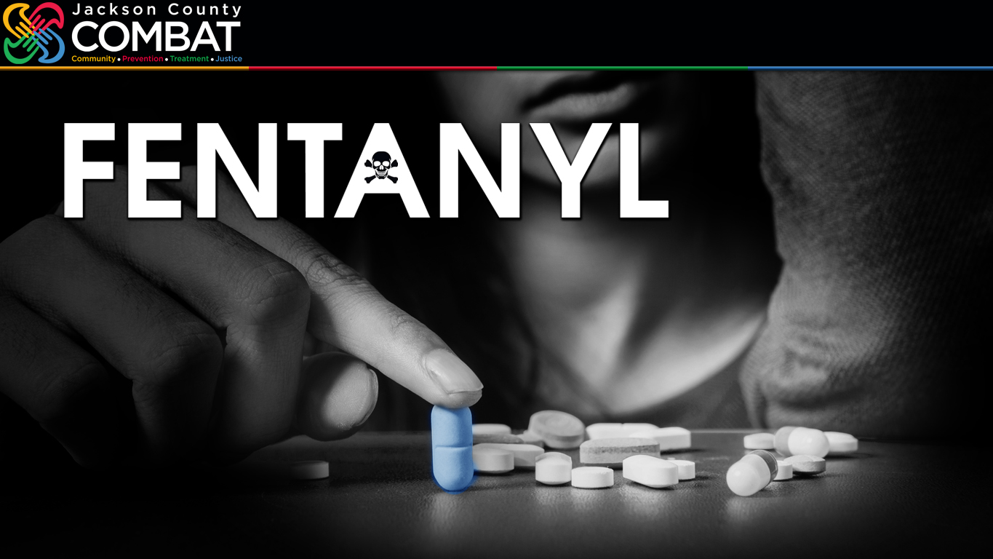
jacksoncountycombat.com/fentanylfacts
1 In 5
FATAL Overdoses
Kids Under 15!
Notes:
According to the Centers for Disease Control & Prevention, 66% of overdose deaths in the United States can be traced to synthetic opioids—like fentanyl.
According to the Jackson County Health Department, one in five fatal overdoses—in Jackson County—is a child under 15 years old.
Ultimately, prevention starts with at least, getting the word out.
How do we reach kids? How do we reach parents? How do we spread the word? Sound the alarm?
Many of you work very closely with kids, so we would like to give you a homework assignment: Conduct a focus group, so we can hear directly from kids. There aren’t that many youths in this room. We need to hear from them. What they have to say and what do they believe other kids will listen to about this life-and-death issue?

Slide 5

jacksoncountycombat.com/fentanylfacts
What messaging targeting adults can we use to help reduce fentanyl overdoses?
What messaging targeting youth can we use to help reduce fentanyl overdoses?
Notes:
We have a two-part question for you as we seek to better get the word out about the lethal danger fentanyl poses.
What messaging can we use for adults to reduce fentanyl overdoses?
What messaging can we use for youth to reduce fentanyl overdoses?

